Slide 1

Models, Testing and Public Affairs: The Case for Crash Test Dummies
Gabriella Mayrend
College of Engineering (Mechanical Engineering)
Mayrendg@my.erau.edu
Hadi Ali, Ph.D.​
Department of Aerospace Engineering​
Hadi.Ali@erau.edu

Slide 2


Acknowledgements
We are grateful to the Arizona Space Grant for their generous funding, which enables us to further pursue and share our research with the world while also supporting our travel efforts.
We extend our heartfelt gratitude to Embry-Riddle Aeronautical University for the invaluable support of its faculty and staff, as well as access to the Writing and Design Center and library resources for our research. Additionally, we appreciate the URI Grant funding, which has allowed us to dedicate quality time and effort to our work.
Notes:
General introduction slide

Slide 3
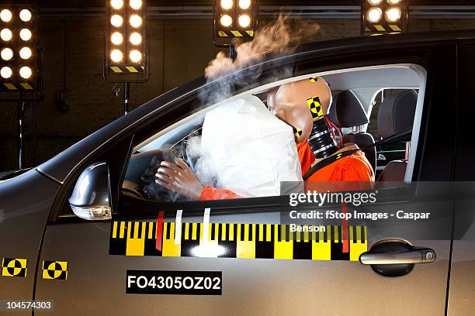
Crash Test Models Do Not
Represent Average Female
Crash testing safety has been known to rely on crash test dummy models created in the 1950s that are modeled after men.
https://www.wdsu.com/article/crash-test-dummies-looking-more-like-americans-heavier-and-older/8698508
Notes:
General introduction slide

Slide 4
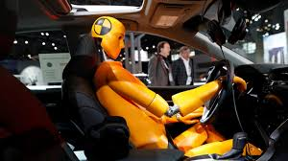
Problem Statement
Current female crash test dummies (4'11'', 108 lbs)
The average American female is (5'4'', 120 lbs)
This raises safety concerns due to the gap.
National Highway Traffic Safety Administration (n.d.). Laws and Regulations. NHTSA.
Retrieved January 1, 2025, from https://www.nhtsa.gov/laws-regulations
https://abcnews.go.com/GMA/Living/modern-female-crash-dummies-improve-safety-women-experts/story?id=108326314
Notes:
Full text slide

Slide 5
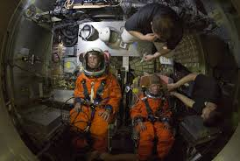
The History of The Crash Test Dummy
The first instance of a crash test dummy being used in spacecraft testing dates back to the Project Mercury program in the late 1950s and early 1960s.
This test was conducted to measure the forces an astronaut would experience.
Swenson, L. S., Grimwood, J. M., & Alexander, C. C. (1989). This New Ocean: A History of Project Mercury. NASA Special Publication-4201.
https://www.cnet.com/science/nasa-crash-test-dummies-take-one-for-the-space-team/
Notes:
Full text slide

Slide 6
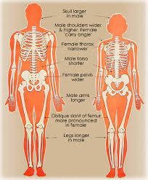
Physiology and Anatomy
Women generally have lower bone density, different fat distribution, and distinct hip, chest, and pelvic structures.
Barry, K. (2019). “The Crash Test Bias: How Male-Focused Testing Puts Female Drivers at
Risk” Consumer Reports. Retrieved January 1, 2025, from https://www.consumerreports.org/carsafety/crash-test-bias-how-male-focused-testing-puts-female-drivers-at-risk/
https://fairplayforwomen.com/biological-sex-differences/
Notes:
Full text slide

Slide 7
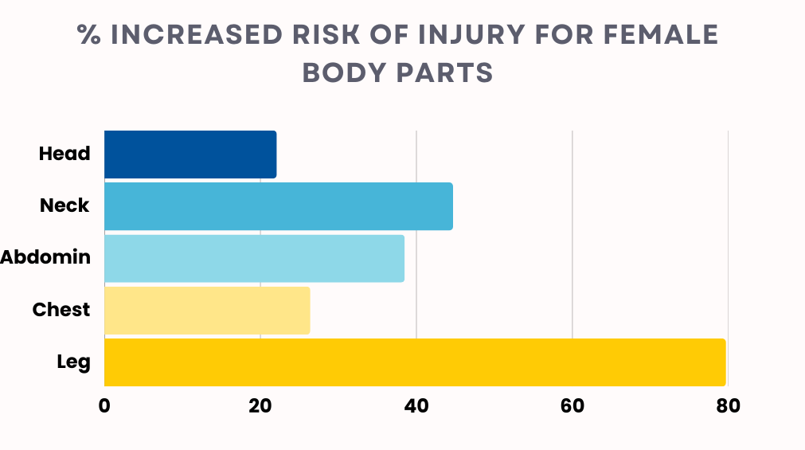
% Dataon this slide
Notes:
Right click
Select Change Picture from file to change out the photo

Slide 8
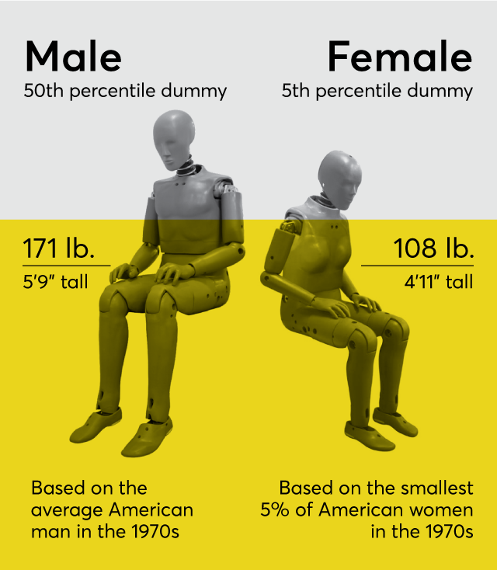
Gender Bias In Crash Testing
Studies have shown that women are more likely to suffer whiplash, chest injuries, and internal trauma due to seatbelt and airbag designs optimized for male bodies.
"Women in Cars: How Gender Bias Affects Crash Test Safety" (2020), National Highway Traffic Safety Administration (NHTSA). This report discusses the disparity between male-based crash test dummies and the lack of a representative female dummy.
https://www.topgear.com/car-news/crash/new-female-crash-test-dummy-will-improve-car-safety-women
Notes:
Full text slide

Slide 9
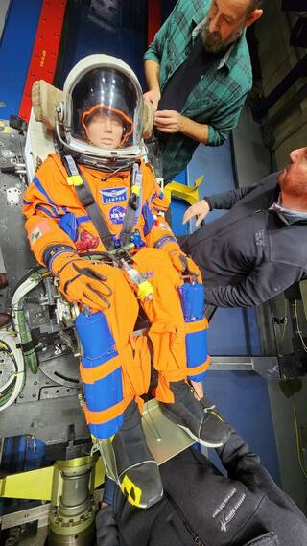
Barriers to Change
The impact of real injuries on testing programs supersedes statistics.
Another large barrier has been cost
  A dummy costs can range from $100,000 to a $1 million dollars.
Ferris, R. (2022) “Why crash test dummies cost $1 million.” CNBC, Retrieved January 1,
2025, from https://www.cnbc.com/video/2022/03/19/why-crash-test-dummies-cost-1-
million.html#:~:text=Autos-
,Why%20crash%20test%20dummies%20cost%20%241%20million,dummies%20run%20closer
%20to%20%241%2C000%2C000
https://www.nasa.gov/centers-and-facilities/johnson/nasa-testing-on-artemis-i-manikin-informs-future-crewed-missions/
Notes:
Full text slide

Slide 10
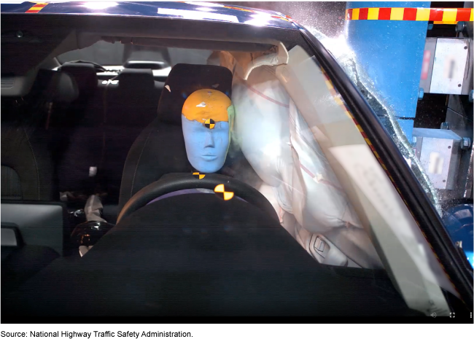
Public Awareness
Not a single person prior to tan interview or conversation with me was aware of the discrepancy we are studying in the crash test dummies.
Notes:
Full text slide

Slide 11
Summary and Future Directions
The inclusion of more representative crash test dummies is vital. Making such major changes to safety standards is needed;
Our future goals consist of creating greater public awareness to push for a policy change by:
  Publishing a paper on the topic, as well as attending multiple academic conferences.
  We intend to do a greater analysis study on the dummy itself using simulation aswell.
Notes:
Full text slide

